Slide 1

Credit Card Analysis
Snehal Sugandh Kamble
Prasanna Prakash
Piyush Anil Patil

Slide 2
Objective
The primary objective of this project is to analyze credit card data & provide valuable insights into customer behavior, needs, and preferences. Our primary stakeholder for this project will be credit card issuing company. By examining the data, we can assist the credit card company in making data-driven decisions to improve customer satisfaction, reduce customer attrition, and enhance the overall credit card experience.
This project will thus help credit card issuer to better understand its customer base and identify specific segments with distinct characteristics. By doing so, the issuer can tailor its strategies to meet the unique needs of different customer groups. Furthermore, the analysis will uncover factors contributing to customer attrition, allowing the issuer to implement measures to retain more customers. In essence, the project is aimed at providing actionable insights that will enable the credit card issuer to optimize its operations and offer improved services.
Our project can help the company to achieve higher customer satisfaction, reduced attrition, and more effective customer engagement. With the insights generated it can guide strategic decisions, marketing teams, and customer support services resulting in business growth.

Slide 3
Stakeholder
Stakeholder: This project has the potential to guide strategic decisions, empower marketing teams, and enhance customer support services. The insights generated will shape the future of the credit card issuing company, resulting in higher customer satisfaction, reduced attrition, and more effective customer engagement.
In essence, the project aligns with our commitment to delivering exceptional service to our valued customers and achieving sustainable business success.

Slide 4
Bank is our Stakeholder
This project has the potential to guide strategic decisions, empower marketing teams, and enhance customer support services. The insights generated will shape the future of the credit card issuing company, resulting in higher customer satisfaction, reduced attrition, and more effective customer engagement.
In essence, the project aligns with our commitment to delivering exceptional service to our valued customers and achieving sustainable business success.

Slide 5
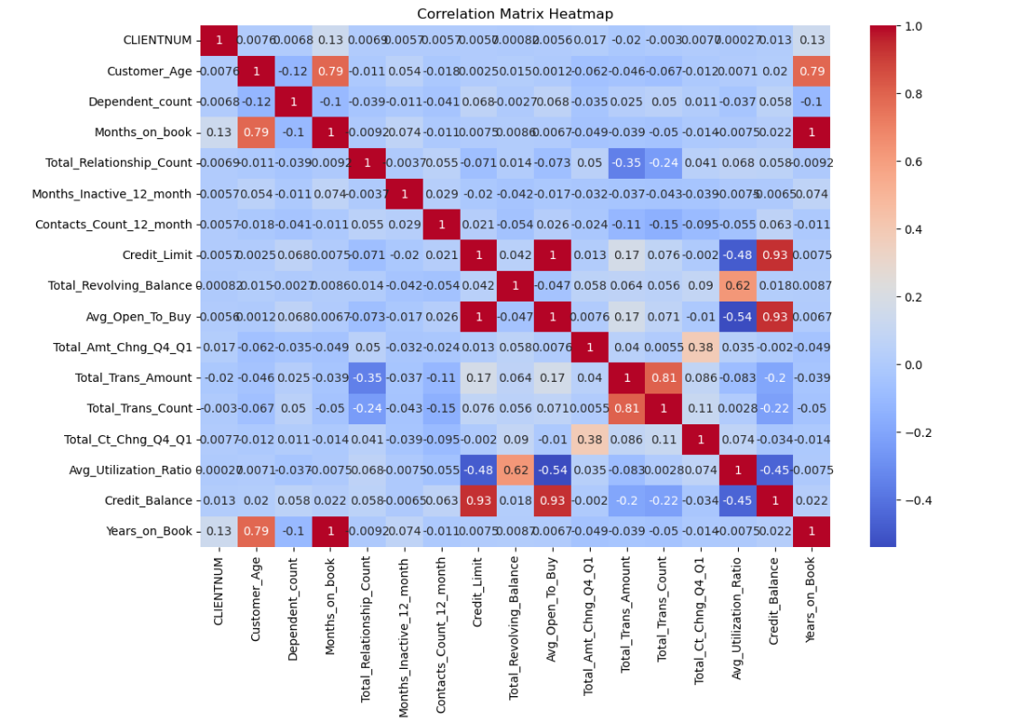
Correlation Matrix Heatmap

Slide 6
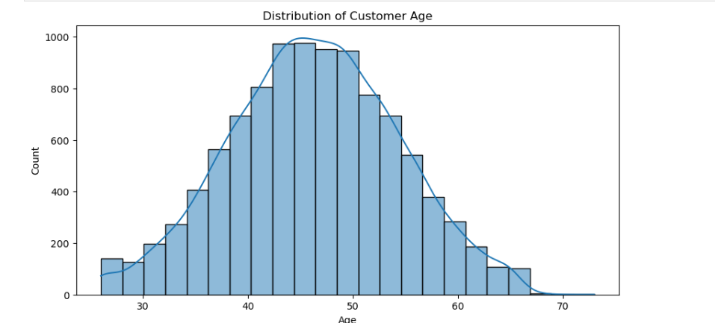
Histogram

Slide 7
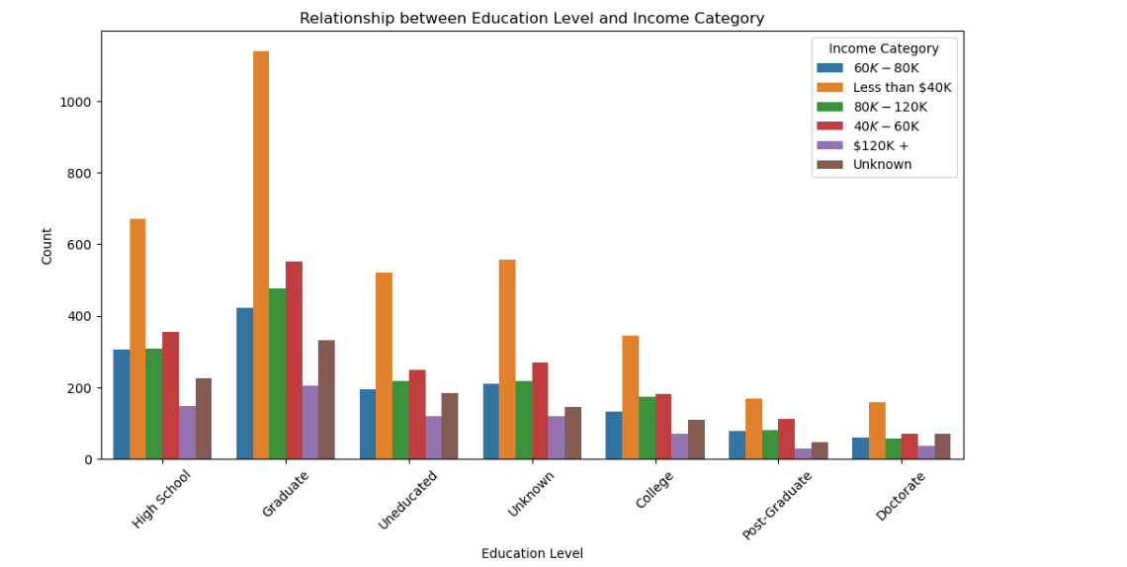
Bar Plot

Slide 8
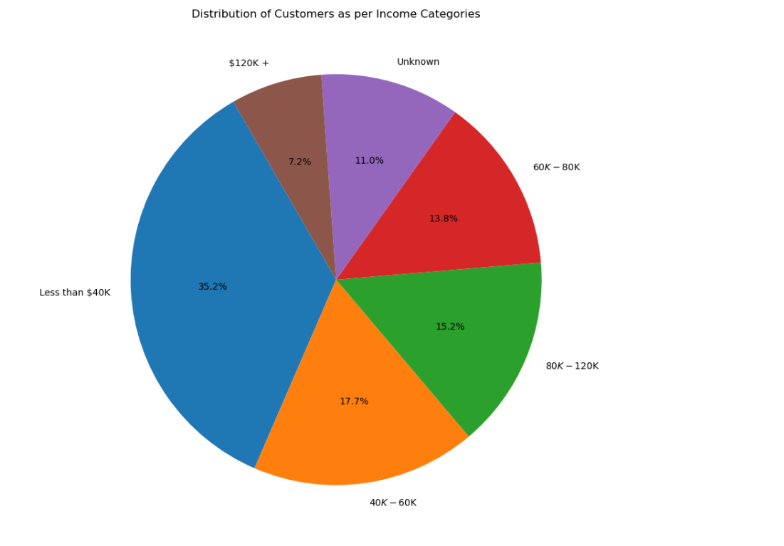

Slide 9
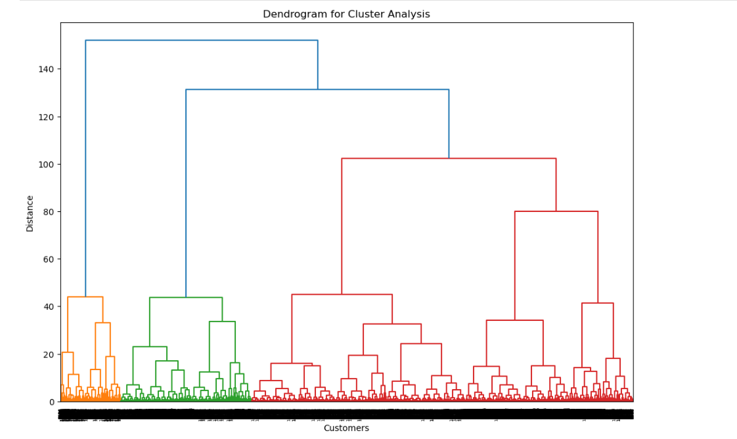

Slide 10
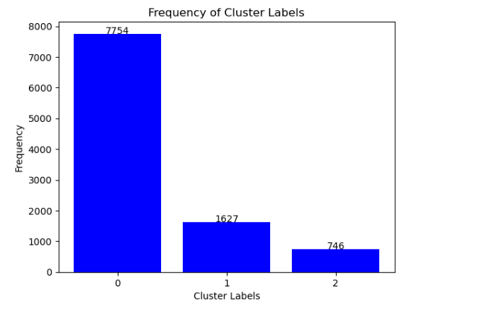

Slide 11
Findings
In all test cases, irrespective of the number of nearest neighbors (k) used, ranging from 1 to 9, the predicted K-Means cluster label for the example data points remains consistently 0. This indicates a strong similarity between the example data points and the customer profiles in Cluster 0, as determined by K-Means clustering.
Recommendations:
1. Consistency Across k Values: The consistent prediction across different k values suggests that the example data points closely resemble Cluster 0. Any new customers resembling these example data points should be treated similarly to those in Cluster 0.
2. Cluster 0 Characteristics: Cluster 0 represents "Low-Engagement but Stable Customers." For new customers resembling the example data points, strategies should focus on increasing engagement through targeted offers or loyalty programs.

Slide 12
Further Analysis
For real-world applications, it's important to use actual new customer data points to gain more actionable insights. This will enhance the model's effectiveness.
Model Robustness
The consistency in cluster label prediction indicates that the k-NN model trained on the K-Means labels is robust, particularly for data points similar to those in Cluster 0.

Slide 13
Personalized Offers
As the new data points are predicted to belong to Cluster 0, personalized marketing strategies effective for Cluster 0 can be directly applied to engage these new customers.
By implementing these insights and recommendations, tailored strategies can be developed for new customers resembling those in existing clusters. This approach aims to enhance customer satisfaction and potentially boost customer engagement.

Slide 14
Key Insights & Recommendations
Findings: - Regardless of 'k,' the predicted K-Means cluster label for example data is consistently 0. - Strong similarity with Cluster 0 suggests effective K-Means clustering.
Recommendations: 1. Consistency Across k Values: Treat new customers like Cluster 0. 2. Cluster 0 Characteristics: Focus on boosting engagement.
Further Analysis: - Use actual customer data for enhanced model effectiveness.
Model Robustness: - k-NN model is robust, especially for Cluster 0.
Personalized Offers: - Apply marketing strategies to engage new customers.
Enhance satisfaction and boost engagement.

Slide 15
Thanks!

